Slide 1

CASE STUDY 4 Group member: Yi Lu; Randy Shi; Yingmin Wang; Yuning Zhao; Yiwen Zheng

Slide 2
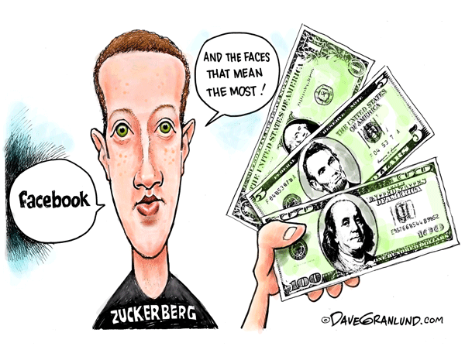
1 Background
5 of 15 Million Facebook Users will click the Amazon ads to make a purchase.
It creates 400 Million revenue for Amazon with only 100 Million cost per year. Great deal!

Slide 3
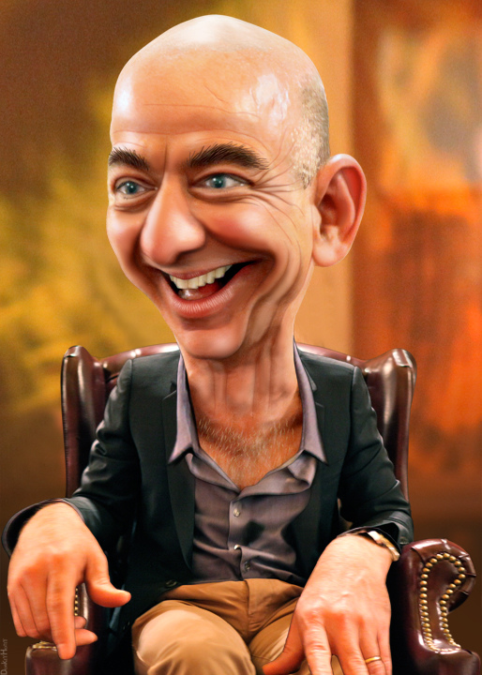
1 Background
Really?

Slide 4
Research Question:
What is the impact of Facebook ads on Amazon sales?

Slide 5
Sample Summary
Total Number: 3,677 customers
1,255 customers always made purchases after clicking the Facebook ads
2,422 customers always made purchases without clicking the Facebook ads
 | Population | Sample
Click FB ads | 5M (33%) | 1255 (34%)
Not click FB ads | 10M (67%) | 2422 (66%)
Total | 15M | 3677

Slide 6

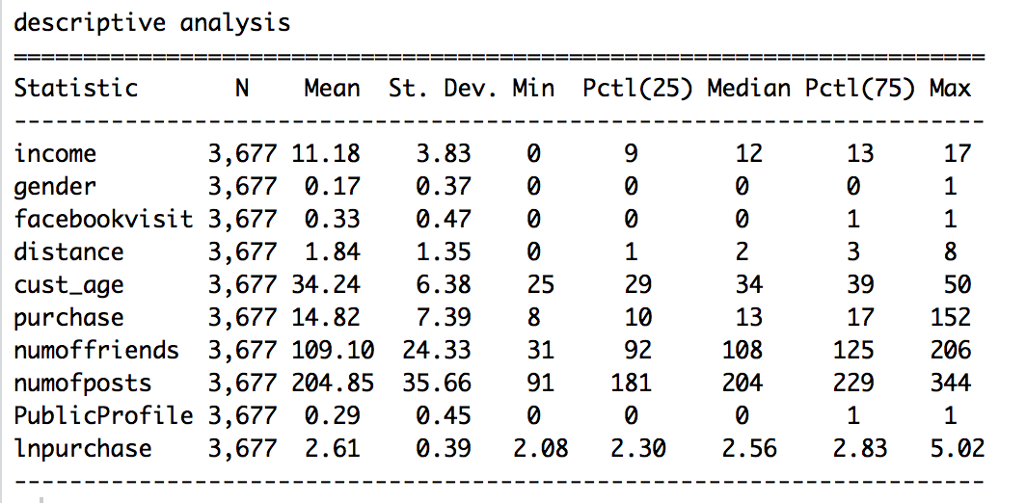
Variables & Theoretical Model
Number of Purchase
Facebook Visits
Gender Age Income Distance

Slide 7
Variables & Theoretical Model
Theoretical Model
Purchase Quantity ~ facebookvisit+ income+ gender+ cust_age +distance

Slide 8
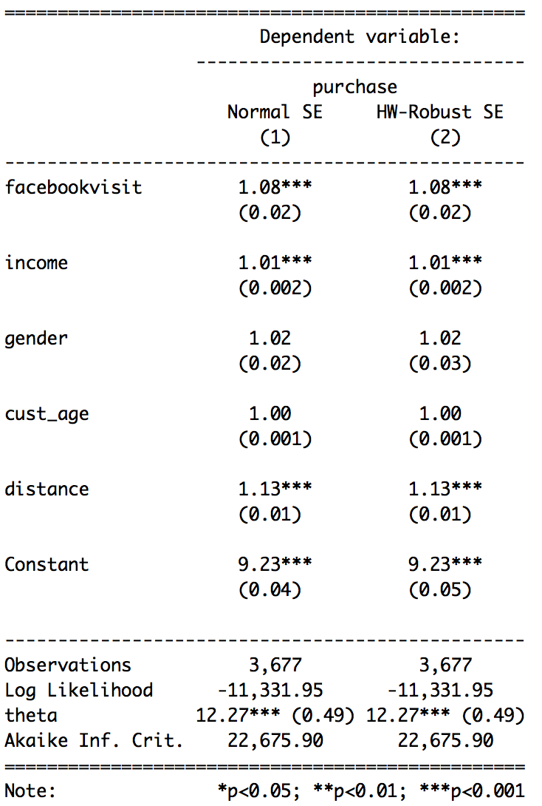
Results: Final Model
8%
Customers who shop after clicking FB ads has 8% more number of purchase than customers who shop directly on amazon, holding other variable constant.

Slide 9
Results: Final Model
Sample Level
2422 customers spent $500 per year on Amazon directly
1255 customers spent 8% more with FB ads
Population Level
5 million customers spent 8% more with FB ads
$500*8%*5M=200M
10 million customers spent $500 per year on Amazon directly
Assumptions:
*Average spent amount per purchase is same for both types’ customers
*5 million customers make purchase always through Facebook

Slide 10
Results: Conclusion
Conclusion:
The benefit brought by the ads on Facebook is up to 200M rather than 400M. The budget of cost should be reduced.

Slide 11
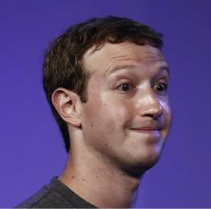
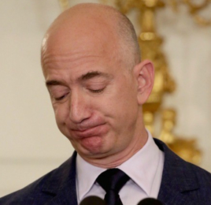
How about 60M?…50M?
Oh com on, Jeff. ……49M after discount?
Sorry Mark…… 200 million is the most optimistic estimate. Actually……

Slide 12
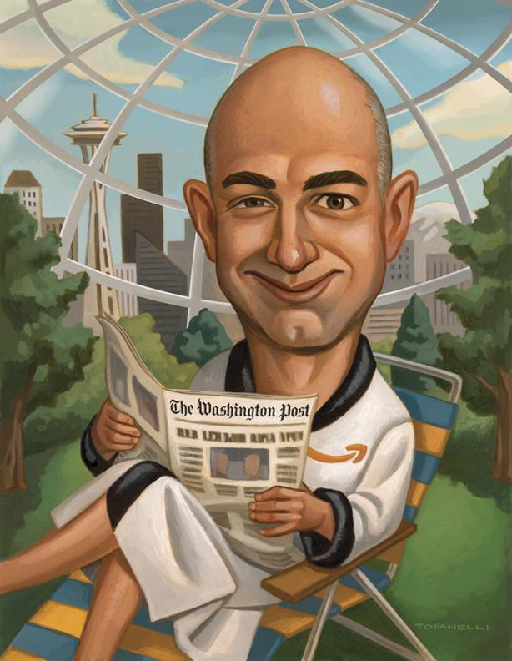
6 Limitation
Interaction with FB may influence the average spending per purchase
Notes:
one fundamental assumption is that on average, these two groups of people spend same amount of money through each purchase, FB ads make customers purchase more frequently but it might not necessarily make them spend more money in total, Possibilities are people who purchase through the ads on FB might ignore the cheaper products on Amazon, on the other hand, for each purchase, they might tend to only buy the advertised product, while the amazon customers might buy more than one item. so they might end up spending more or less money per purchase compare with regular customers. Without additional data, we are not sure if the assumption is the real case, we are not sure if these 200 million is higher or lower than the real additional benefit. Ideally, in addition to the total number of purchase, we’d like to collect data on the dollar amount spent per customer to analyze the additional benefit bought by FB.

Slide 13
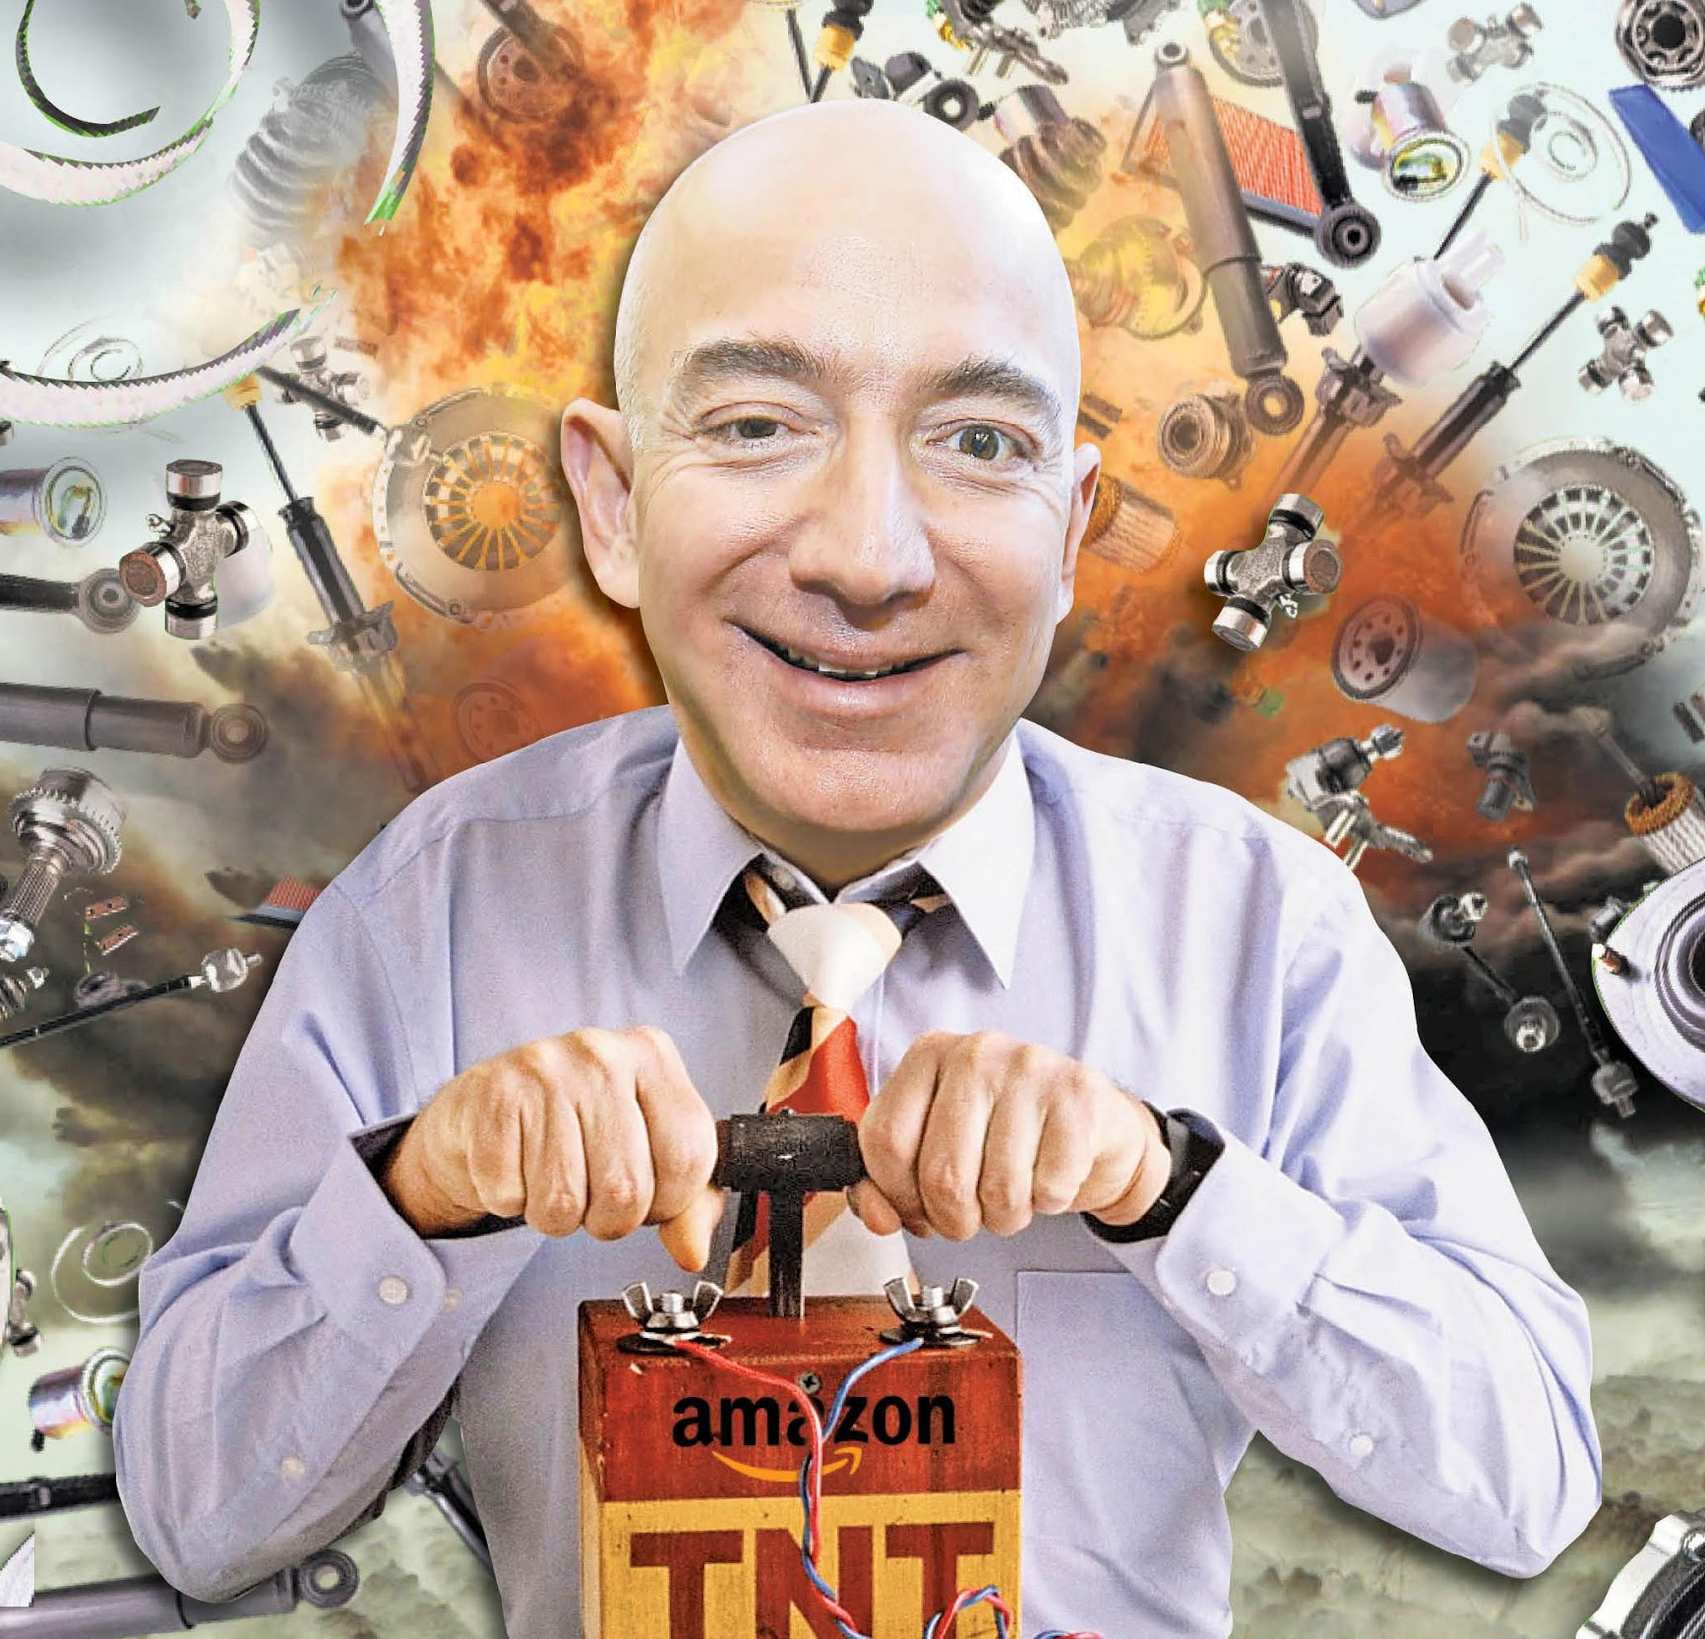
6 Limitation
5M FB customers may behave different from our sampled customers who always purchase through FB Ads
Notes:
not to be able to rule out the possibility that some of the customers purchase through both channels. so the increase in the number of purchase might not be as high as 8% for these 5M customers, therefore, the actual additional benefit might be less than 200 million. Additional information on the 5M customers’ purchase behavior will be beneficial for our study.

Slide 14
Endogeneity.

Slide 15
Endogeneity
OLS and Negative Binomial Models are comparable if OLS estimated coefficient of the key independent variable lies in between the confidence interval of the key independent variable in negative binomial model

Slide 16
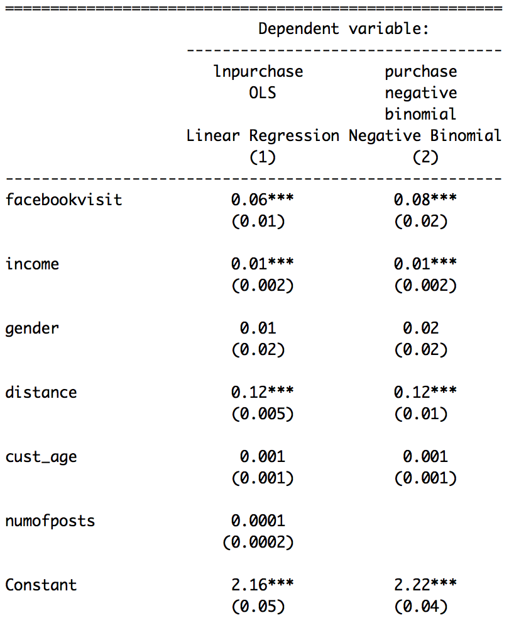
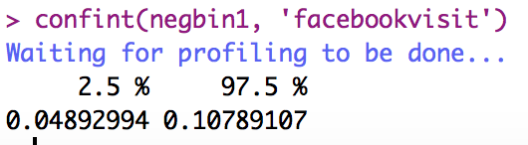
Endogeneity

Slide 17
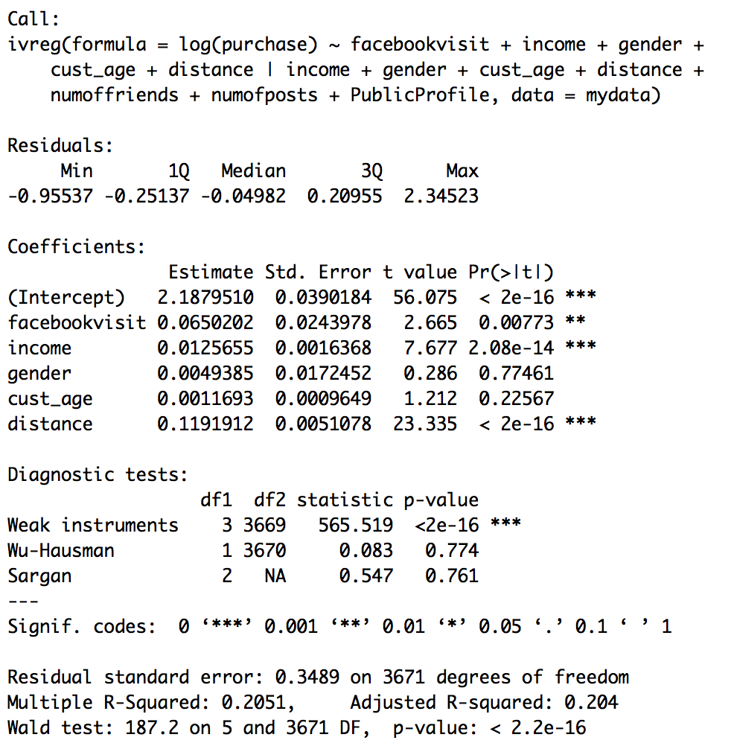
Endogeneity
Instruments Variables:
Number of friends
Number of posts
Public Profile
Conclusion: no endogeneity

Slide 18
THANKS!
Any questions?

Slide 19
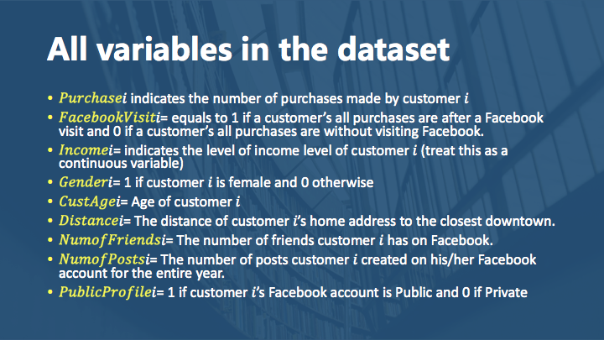

Slide 20
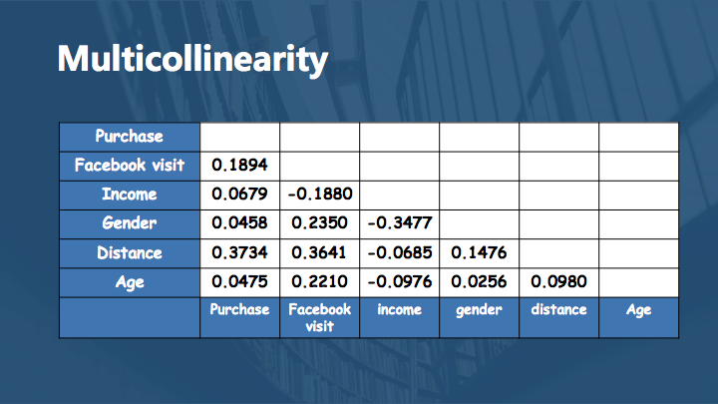
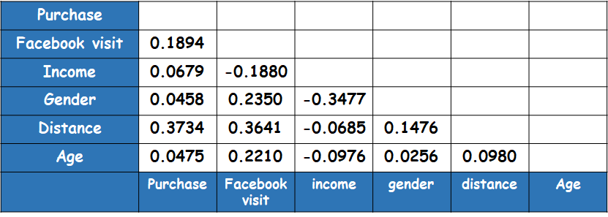

Slide 21
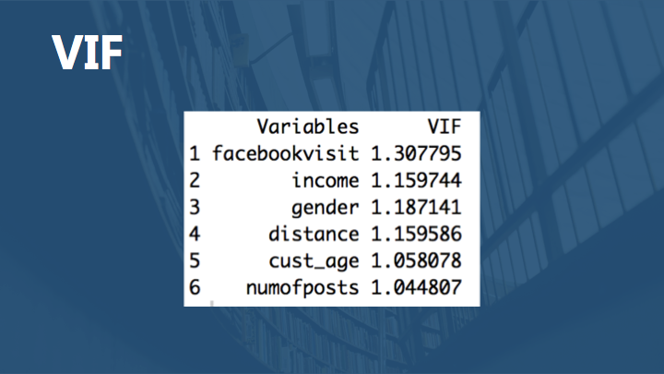
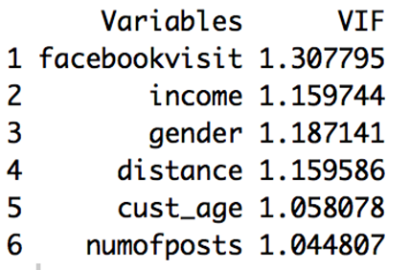

Slide 22
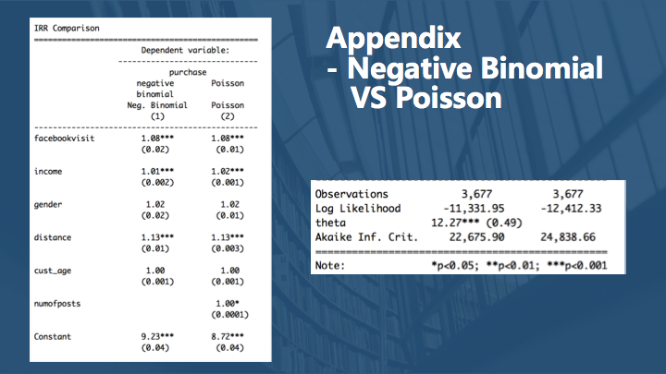
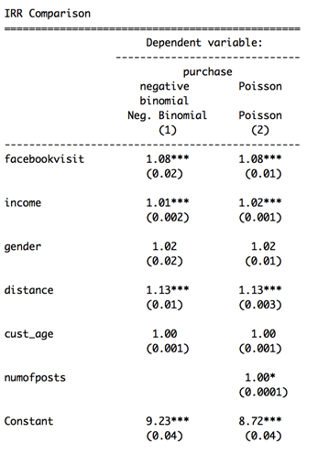
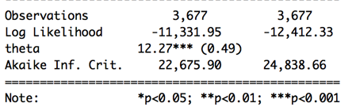

Slide 23
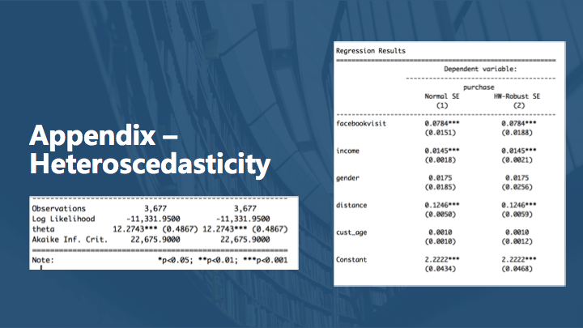
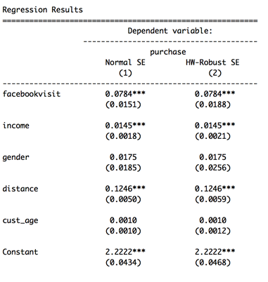
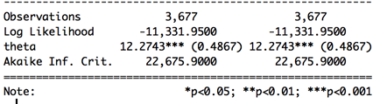

Slide 24

